Slide 1

FUNDAMENTALS OF DATABASE SYSTEMS LESSON 5: The Relational Data Model
Nguyễn Thị Hậu
University of Engineering and Technology,
Vietnam National University in Hanoi (UET-VNU)
nguyenhau@vnu.edu.vn

Slide 2
Chapter Outline
Relational Model Concepts
Relational Model Constraints and Relational Database Schemas
Update Operations and Dealing with Constraint Violations

Slide 3
Relational Model Concepts
The relational Model of Data is based on the concept of a Relation.
A Relation is a mathematical concept based on the ideas of sets.
The strength of the relational approach to data management comes from the formal foundation provided by the theory of relations.
We review the essentials of the relational approach in this chapter.

Slide 4
Relational Model Concepts
The model was first proposed by Dr. E.F. Codd of IBM in 1970 in the following paper: "A Relational Model for Large Shared Data Banks," Communications of the ACM, June 1970.
The above paper caused a major revolution in the field of Database management and earned Ted Codd the coveted ACM Turing Award.

Slide 5
INFORMAL DEFINITIONS
RELATION: A table of values
A relation may be thought of as a set of rows.
A relation may alternately be though of as a set of columns.
Each row represents a fact that corresponds to a real-world entity or relationship.
Each row has a value of an item or set of items that uniquely identifies that row in the table.
Sometimes row-ids or sequential numbers are assigned to identify the rows in the table.
Each column typically is called by its column name or column header or attribute name.

Slide 6
FORMAL DEFINITIONS
A Relation may be defined in multiple ways.
The Schema of a Relation: R (A1, A2, .....An)
Relation schema R is defined over attributes A1, A2, .....An
For Example -
CUSTOMER (Cust-id, Cust-name, Address, Phone#)
Here, CUSTOMER is a relation defined over the four attributes Cust-id, Cust-name, Address, Phone#, each of which has a domain or a set of valid values. For example, the domain of Cust-id is 6 digit numbers.

Slide 7
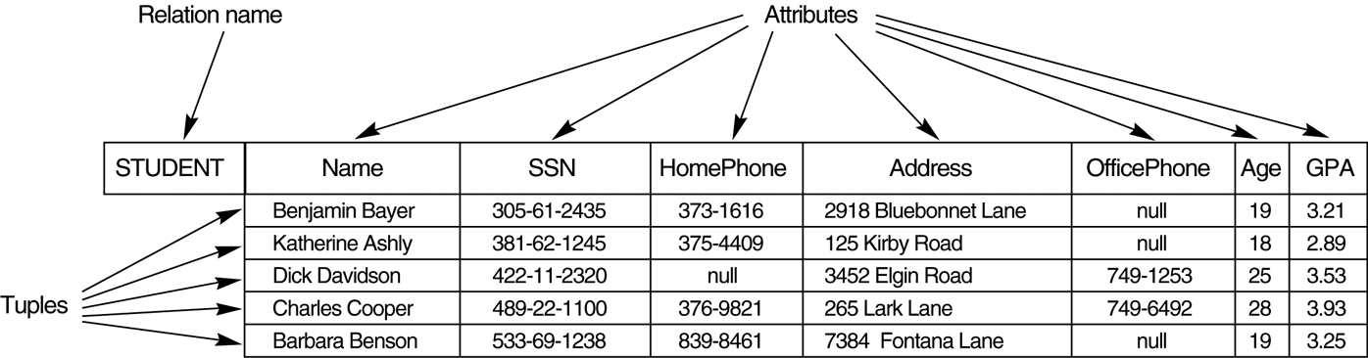
Example

Slide 8
FORMAL DEFINITIONS
A tuple is an ordered set of values
Each value is derived from an appropriate domain.
Each row in the CUSTOMER table may be referred to as a tuple in the table and would consist of four values.
<632895, "John Smith", "101 Main St. Atlanta, GA 30332", "(404) 894-2000"> is a tuple belonging to the CUSTOMER relation.
A relation may be regarded as a set of tuples (rows).
Columns in a table are also called attributes of the relation.

Slide 9
FORMAL DEFINITIONS
A domain has a logical definition: e.g., “USA_phone_numbers” are the set of 10 digit phone numbers valid in the U.S.
A domain may have a data-type or a format defined for it. The USA_phone_numbers may have a format: (ddd)-ddd-dddd where each d is a decimal digit. E.g., Dates have various formats such as monthname, date, year or yyyy-mm-dd, or dd mm,yyyy etc.
An attribute designates the role played by the domain. E.g., the domain Date may be used to define attributes “Invoice-date” and “Payment-date”.

Slide 10
FORMAL DEFINITIONS
The relation is formed over the Cartesian product of the sets; each set has values from a domain; that domain is used in a specific role which is conveyed by the attribute name.
For example, attribute Cust-name is defined over the domain of strings of 25 characters. The role these strings play in the CUSTOMER relation is that of the name of customers.
Formally,
Given R(A₁, A₂, .........., A_{n})
r(R) ⊂ dom (A₁) X dom (A₂) X ....X dom(A_{n})
R: schema of the relation
r of R: a specific "value" or population of R.
R is also called the intension of a relation
r is also called the extension of a relation

Slide 11
FORMAL DEFINITIONS
Let S1 = {0,1}
Let S2 = {a,b,c}
Let R ⊂ S1 X S2
Then for example: r(R) = {<0,a> , <0,b> , <1,c> }
is one possible “state” or “population” or “extension” r of the relation R, defined over domains S1 and S2. It has three tuples.

Slide 12
DEFINITION SUMMARY
Informal Terms |  | Formal Terms
Table |  | Relation
Column |  | Attribute/Domain
Row |  | Tuple
Values in a column |  | Domain
Table Definition |  | Schema of a Relation
Populated Table |  | Extension

Slide 13
CHARACTERISTICS OF RELATIONS
Ordering of tuples in a relation r(R): The tuples are not considered to be ordered, even though they appear to be in the tabular form.
Ordering of attributes in a relation schema R (and of values within each tuple): We will consider the attributes in R(A₁, A₂, ..., A_{n}) and the values in t=<v₁, v₂, ..., v_{n}> to be ordered .
(However, a more general alternative definition of relation does not require this ordering).
Values in a tuple: All values are considered atomic (indivisible). A special null value is used to represent values that are unknown or inapplicable to certain tuples.

Slide 14
CHARACTERISTICS OF RELATIONS
Notation:
- We refer to component values of a tuple t by t[A_{i}] = v_{i} (the value of attribute A_{i} for tuple t).
Similarly, t[A_{u}, A_{v}, ..., A_{w}] refers to the subtuple of t containing the values of attributes A_{u}, A_{v}, ..., A_{w}, respectively.

Slide 15
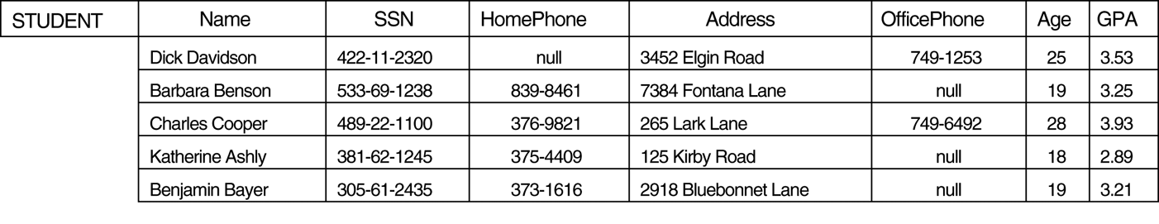
CHARACTERISTICS OF RELATIONS

Slide 16
Relational Model Concepts
Relational Model Constraints and Relational Database Schemas
Update Operations and Dealing with Constraint Violations

Slide 17
Relational Integrity Constraints
Constraints are conditions that must hold on all valid relation instances. There are three main types of constraints:
Key constraints
Entity integrity constraints
Referential integrity constraints

Slide 18
Key Constraints
Superkey of R: A set of attributes SK of R such that no two tuples in any valid relation instance r(R) will have the same value for SK. That is, for any distinct tuples t1 and t2 in r(R), t1[SK] ≠ t2[SK].
Key of R: A "minimal" superkey; that is, a superkey K such that removal of any attribute from K results in a set of attributes that is not a superkey.
Example: The CAR relation schema:
CAR(State, Reg#, SerialNo, Make, Model, Year)
has two keys Key1 = {State, Reg#}, Key2 = {SerialNo}, which are also superkeys. {SerialNo, Make} is a superkey but not a key.
If a relation has several candidate keys, one is chosen arbitrarily to be the primary key. The primary key attributes are underlined.

Slide 19
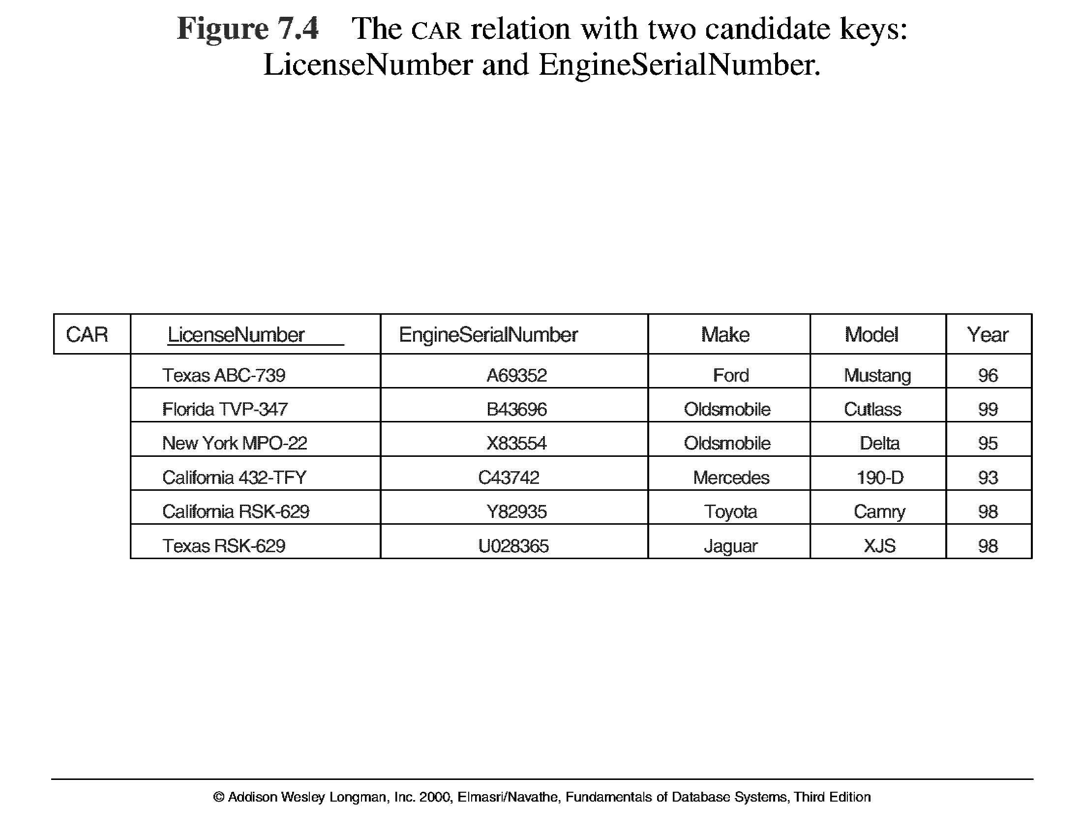
Key Constraints
5.4

Slide 20
Entity Integrity
Relational Database Schema: A set S of relation schemas that belong to the same database. S is the name of the database.
S = {R₁, R₂, ..., R_{n}}
Entity Integrity: The primary key attributes PK of each relation schema R in S cannot have null values in any tuple of r(R). This is because primary key values are used to identify the individual tuples.
t[PK] ≠ null for any tuple t in r(R)
Note: Other attributes of R may be similarly constrained to disallow null values, even though they are not members of the primary key.

Slide 21
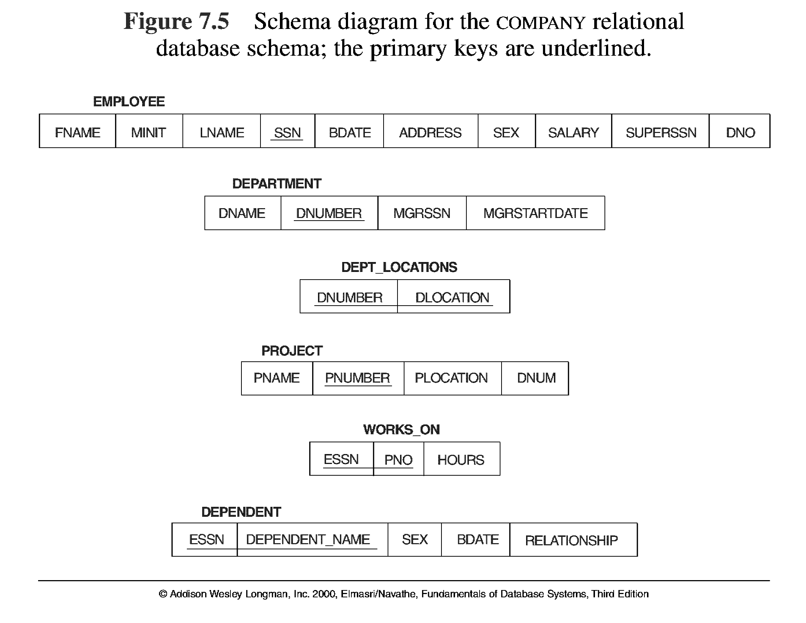
5.5

Slide 22
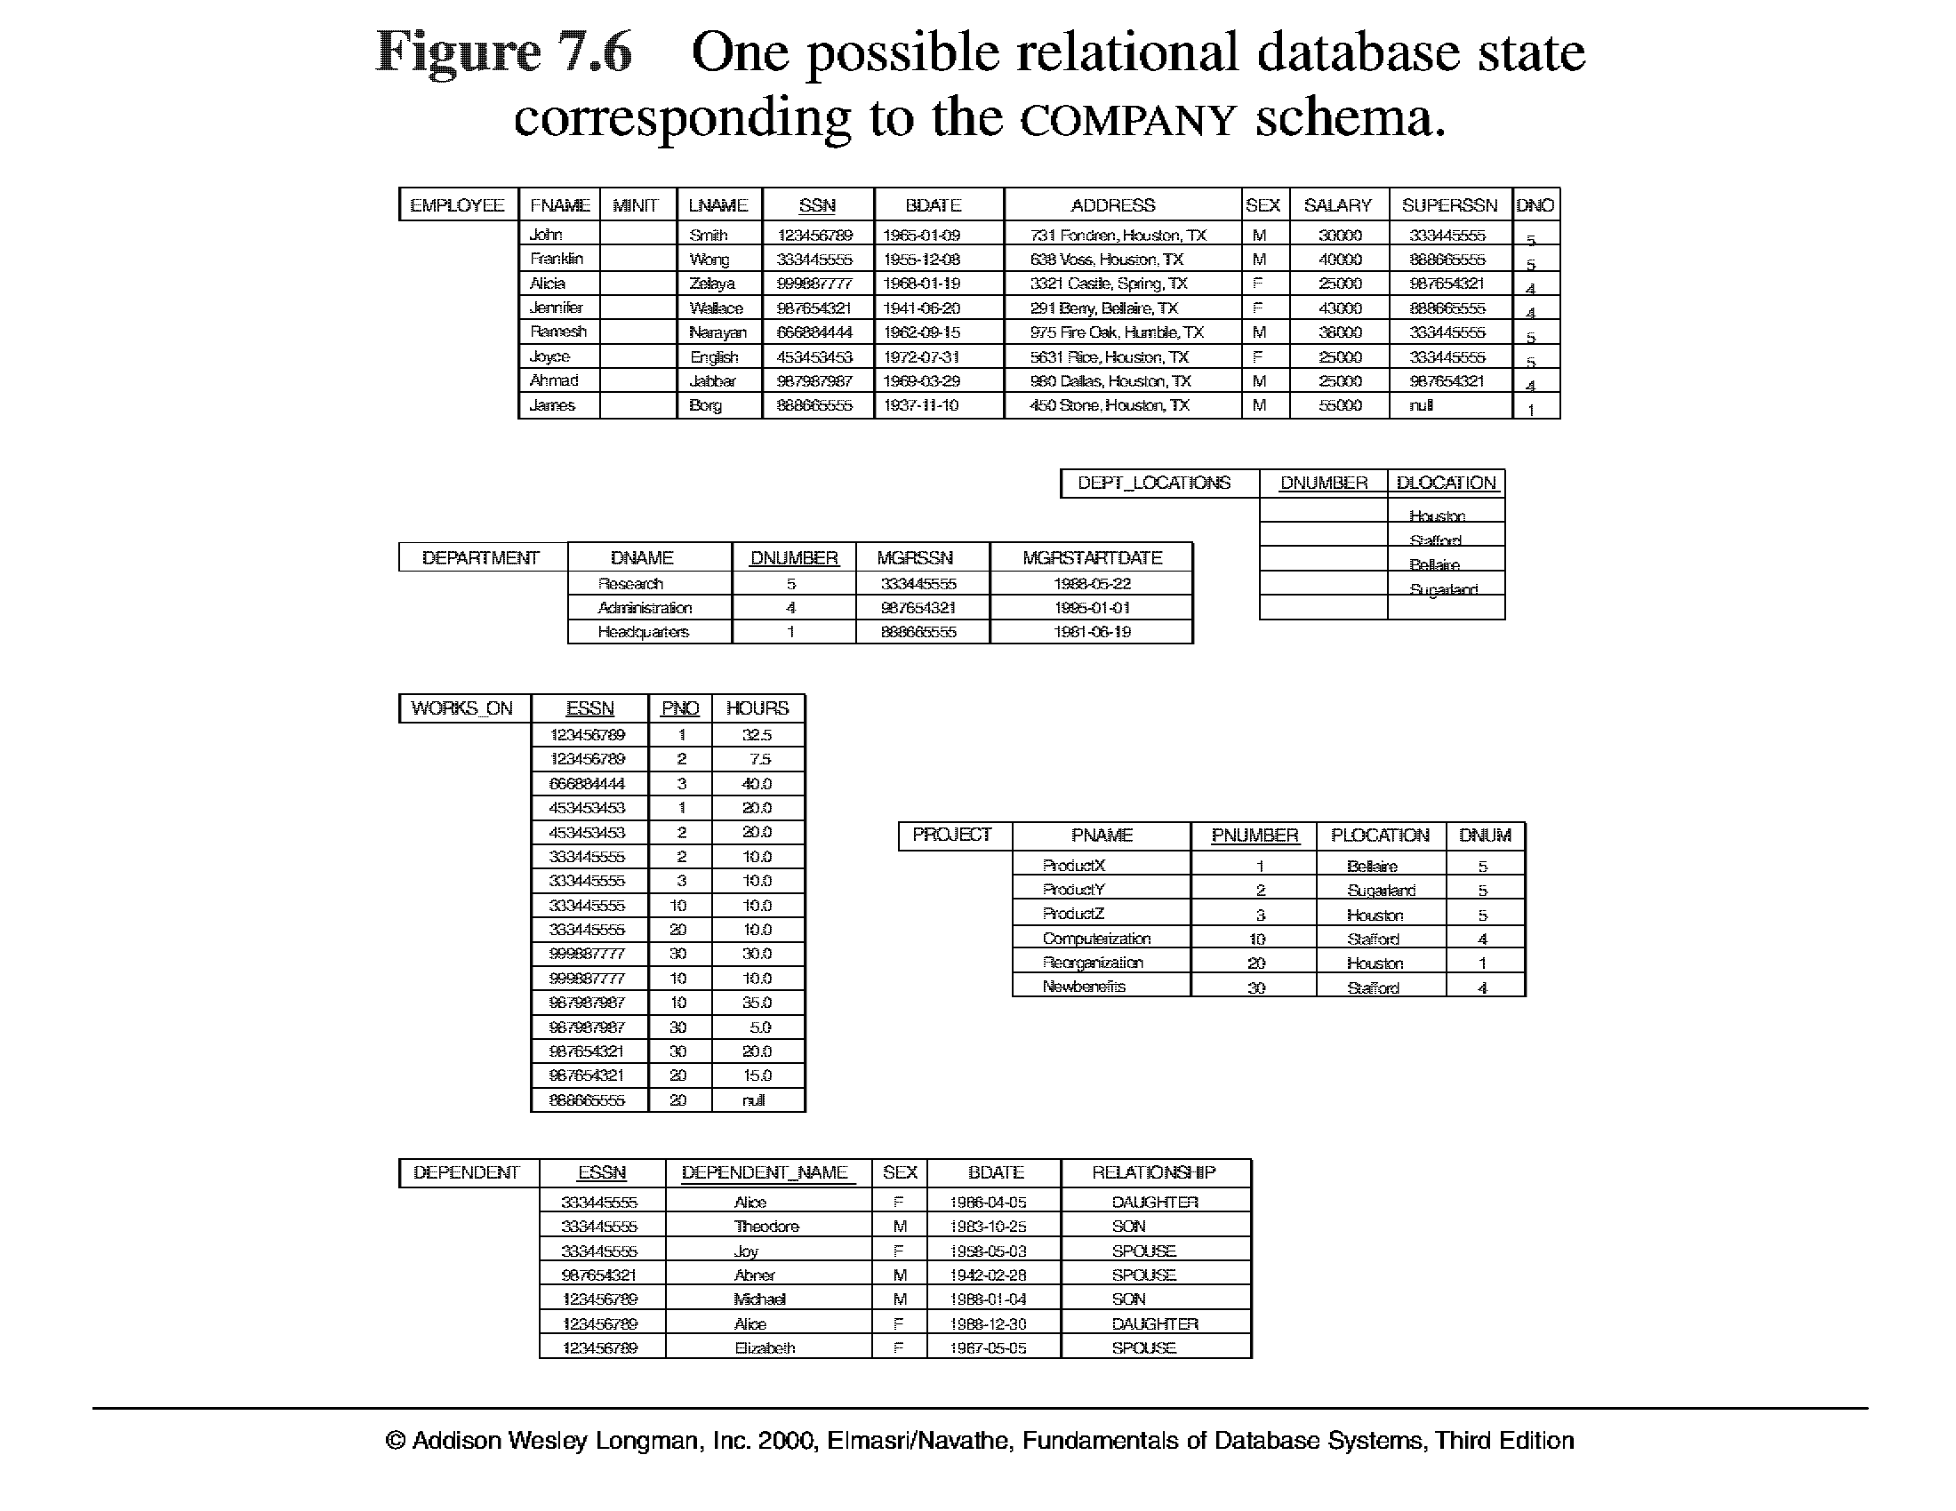
5.6

Slide 23
Referential Integrity
A constraint involving two relations (the previous constraints involve a single relation).
Used to specify a relationship among tuples in two relations: the referencing relation and the referenced relation.
Tuples in the referencing relation R₁ have attributes FK (called foreign key attributes) that reference the primary key attributes PK of the referenced relation R₂. A tuple t₁ in R₁ is said to reference a tuple t₂ in R₂ if t₁[FK] = t₂[PK].
A referential integrity constraint can be displayed in a relational database schema as a directed arc from R₁.FK to R₂.

Slide 24
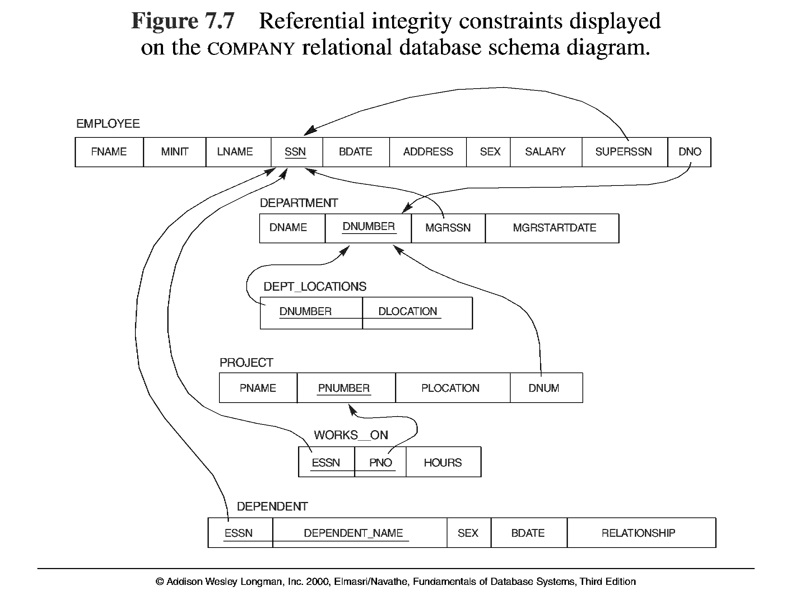
5.7

Slide 25
Referential Integrity Constraint
Statement of the constraint
The value in the foreign key column (or columns) FK of the the referencing relation R₁ can be either:
(1) a value of an existing primary key value of the corresponding primary key PK in the referenced relation R_{2,}, or..
(2) a null.
In case (2), the FK in R₁ should not be a part of its own primary key.

Slide 26
Other Types of Constraints
Semantic Integrity Constraints:
based on application semantics and cannot be expressed by the model per se
E.g., “the max. no. of hours per employee for all projects he or she works on is 56 hrs per week”
A constraint specification language may have to be used to express these
SQL-99 allows triggers and ASSERTIONS to allow for some of these

Slide 27
Relational Model Concepts
Relational Model Constraints and Relational Database Schemas
Update Operations and Dealing with Constraint Violations

Slide 28
Update Operations on Relations
INSERT a tuple.
DELETE a tuple.
MODIFY a tuple.
Integrity constraints should not be violated by the update operations.
Several update operations may have to be grouped together.
Updates may propagate to cause other updates automatically. This may be necessary to maintain integrity constraints.

Slide 29
Update Operations on Relations
In case of integrity violation, several actions can be taken:
Cancel the operation that causes the violation (REJECT option)
Perform the operation but inform the user of the violation
Trigger additional updates so the violation is corrected (CASCADE option, SET NULL option)
Execute a user-specified error-correction routine

Slide 30
Homework
Consider the following relations for a database that keeps track of student enrollment in courses and the books adopted for each course:
STUDENT(SSN, Name, Major, Bdate)
COURSE(Course#, Cname, Dept)
ENROLL(SSN, Course#, Quarter, Grade)
BOOK_ADOPTION(Course#, Quarter, Book_ISBN)
TEXT(Book_ISBN, Book_Title, Publisher, Author)
Draw a relational schema diagram specifying the foreign keys for this schema.

Slide 31


